Slide 1

Life Long Learning
Hung-yi Lee
李宏毅
https://www.pearsonlearned.com/lifelong-learning-will-help-workers-navigate-future-work/

Slide 2

你用同一個腦學習
機器學習的每一堂課
但是每一個作業你都
訓練不同的類神經網路
能不能每次作業都訓練同一個類神經網路呢？
https://www.forbes.com/sites/kpmg/2018/04/23/the-changing-nature-of-work-why-lifelong-learning-matters-more-than-ever/#4e04e90e1e95

Slide 3

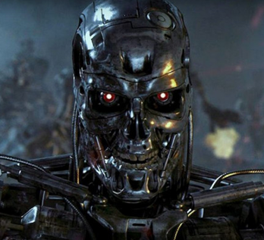
Life Long Learning (LLL)
Continuous Learning, Never Ending Learning, Incremental Learning
I can solve task 1.
I can solve tasks 1&2.
I can solve tasks 1&2&3.
…
Learning Task 1
Learning Task 2
Learning Task 3
Notes:
https://vlomonaco.github.io/core50/benchmarks.html

Slide 4
Life-long Learning
Knowledge Retention
Knowledge Transfer
Model Expansion
but NOT Intransigence
but Parameter Efficiency
Notes:
Intransigence: ɪnˋtrænsədʒəns n.
不妥協；不讓步
Constraint:
cannot store all the previous data

Slide 5
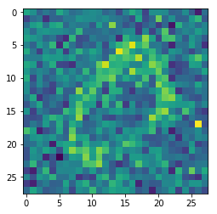
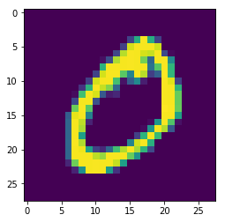
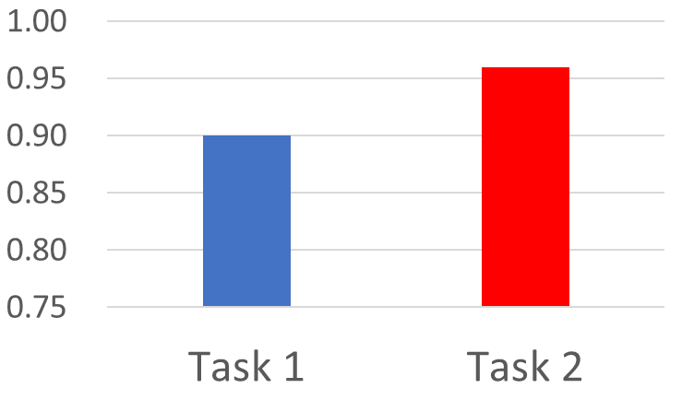
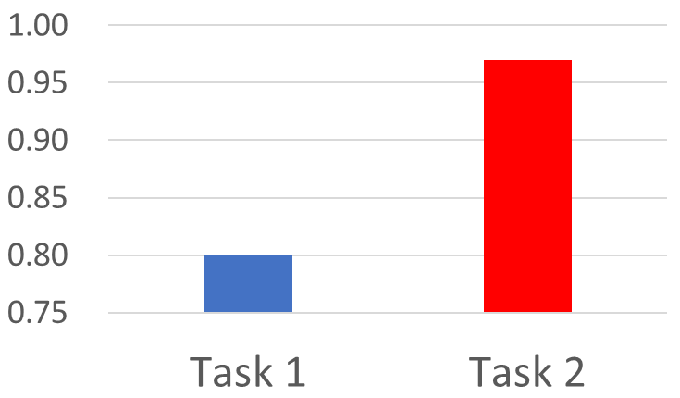
Example – Image
=
3 layers, 50 neurons each
Task 1
Task 2
This is “0”.
This is “0”.
96%
97%
90%
Forget!!!
80%

Slide 6
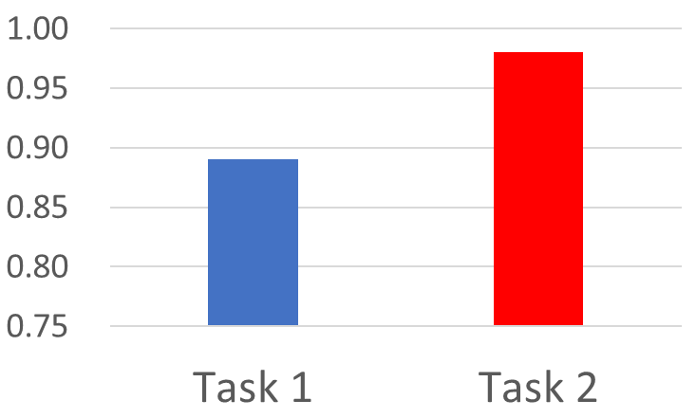
Learning Task 1
Learning Task 2
96%
97%
90%
Forget!!!
80%
98%
Learning Task 1
89%
Learning Task 2
明明可以把 Task 1 和 2 都學好，為什麼會變成這樣子呢!?

Slide 7
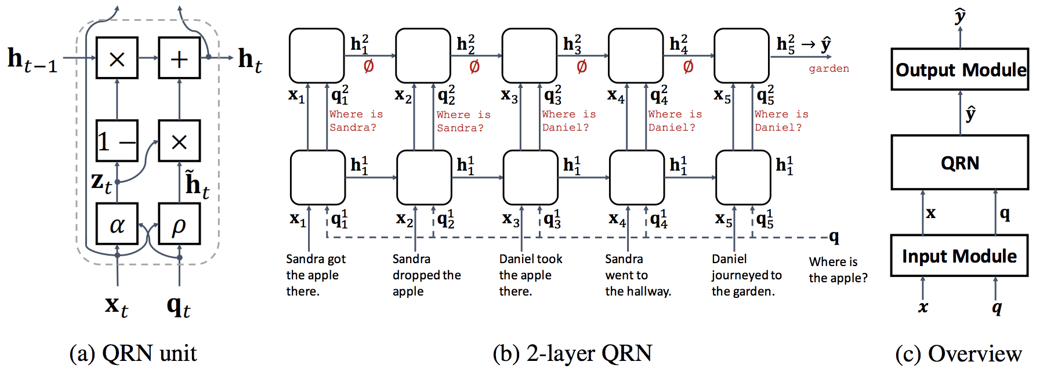
Example – Question Answering
https://arxiv.org/pdf/1502.05698.pdf
Given a document, answer the question based on the document.
There are 20 QA tasks in bAbi corpus.
Train a QA model through the 20 tasks

Slide 8
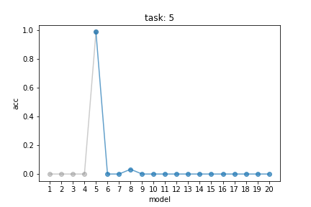
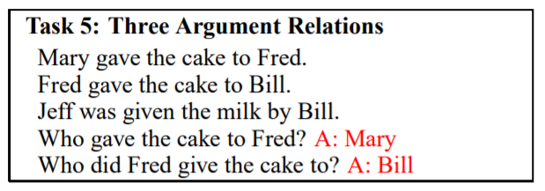
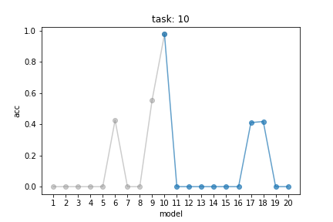
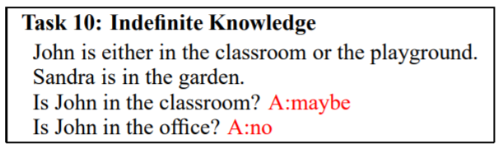
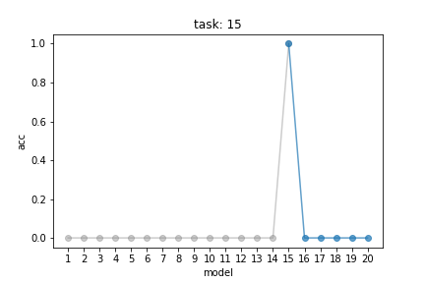
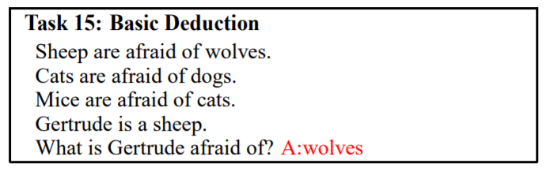

Slide 9
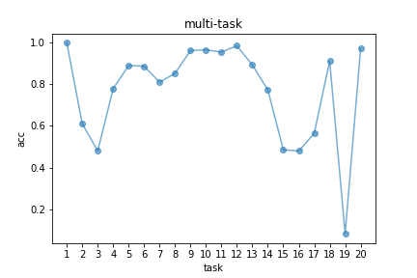
Example – Question Answering
Sequentially train the 20 tasks
Jointly training the 20 tasks
是不為也
非不能也
感謝何振豪同學提供實驗結果

Slide 10
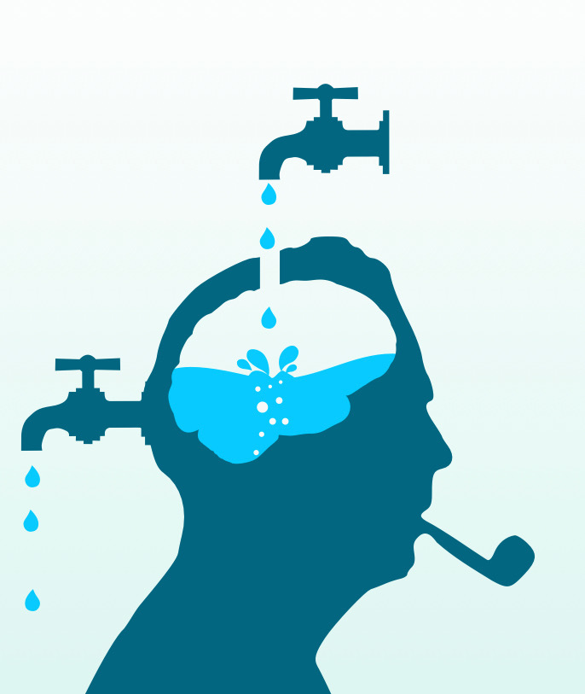
Catastrophic Forgetting
Notes:
Little Data for Regularization

Slide 11
Wait a minute ……
Learning Task 1
Learning Task 2
Multi-task training can solve the problem!
Multi-task training can be considered as the upper bound of LLL.
Using all the data for training
Computation issue
Training Data
for Task 1
Training Data
for Task 999
Training Data
for Task 1000
……
Always keep the data
Storage issue

Slide 12
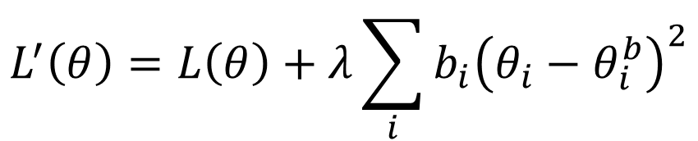
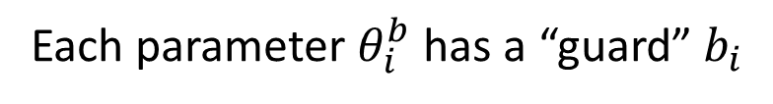
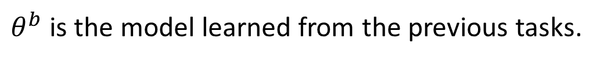
Elastic Weight Consolidation (EWC)
Basic Idea: Some parameters in the model are important to the previous tasks. Only change the unimportant parameters.
$θ^{b}$ is the model learned from the previous tasks.
Each parameter $θ_{i}^{b}$ has a “guard” $b_{i}$
How important this parameter is
Loss for current task
$$L^{′}\left(θ\right)=L\left(θ\right)+λ\sum_{i}{b_{i}{\left(θ_{i}−θ_{i}^{b}\right)}^{2}}$$
Loss to be optimized
Parameters to be learning
Parameters learned from previous task
Notes:
Elastic adj.
有彈性的
Consolidation鞏固，加強，強化

Slide 13
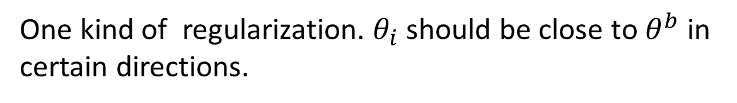
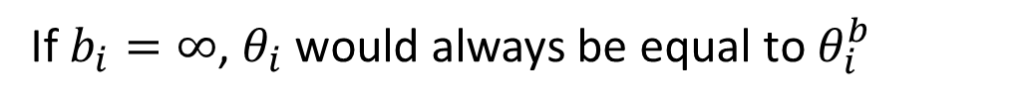
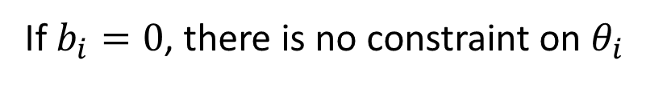
Elastic Weight Consolidation (EWC)
Basic Idea: Some parameters in the model are important to the previous tasks. Only change the unimportant parameters.
$θ^{b}$ is the model learned from the previous tasks.
Each parameter $θ_{i}^{b}$ has a “guard” $b_{i}$
One kind of regularization. $θ_{i}$ should be close to $θ^{b}$ in certain directions.
$$L^{′}\left(θ\right)=L\left(θ\right)+λ\sum_{i}{b_{i}{\left(θ_{i}−θ_{i}^{b}\right)}^{2}}$$
If $b_{i}=0$, there is no constraint on $θ_{i}$
If $b_{i}=∞$, $θ_{i}$ would always be equal to $θ_{i}^{b}$

Slide 14









Elastic Weight Consolidation (EWC)
Task 1
Task 2
$$θ^{0}$$
$$θ^{∗}$$
$$θ^{∗}$$
$$θ_{2}$$
$$θ_{2}$$
Forget!
$$θ^{b}$$
$$θ^{b}$$
$$θ_{1}$$
$$θ_{1}$$
The error surfaces of tasks 1 & 2.
(darker = smaller loss)

Slide 15


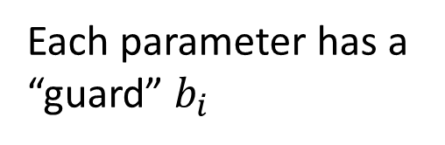

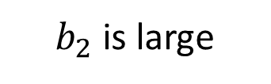

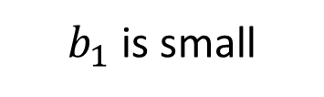
Elastic Weight Consolidation (EWC)
Task 1
$$θ_{1}^{b}$$
$$θ^{0}$$
$$θ_{1}$$
Small 2nd derivative
$b_{1}$ is small
動到沒關係
$$θ_{2}$$
$$θ_{2}^{b}$$
$$θ^{b}$$
$$θ_{2}$$
$$θ_{1}$$
Large 2nd derivative
Each parameter has a “guard” $b_{i}$
$b_{2}$ is large
動到會出事

Slide 16


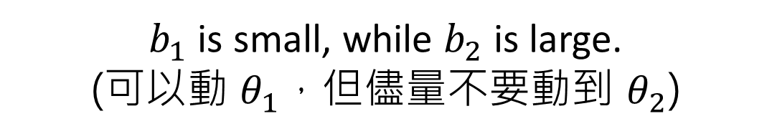

Elastic Weight Consolidation (EWC)
Task 1
Task 2
$$θ^{0}$$
Do not forget!
$$θ^{∗}$$
$$θ_{2}$$
$$θ_{2}$$
$$θ^{∗}$$
$$θ^{∗}$$
$$θ^{b}$$
$$θ^{b}$$
$$θ_{1}$$
$$θ_{1}$$
$b_{1}$ is small, while $b_{2}$ is large.
(可以動 $θ_{1}$，但儘量不要動到 $θ_{2}$)

Slide 17
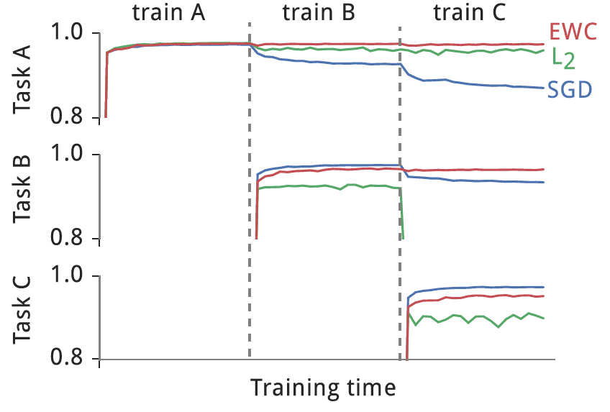
Elastic Weight Consolidation (EWC)
Intransigence
MNIST permutation, from the original EWC paper

Slide 18
Elastic Weight Consolidation (EWC)
Elastic Weight Consolidation (EWC)
http://www.citeulike.org/group/15400/article/14311063
Synaptic Intelligence (SI)
https://arxiv.org/abs/1703.04200
Memory Aware Synapses (MAS)
Special part: Do not need labelled data
https://arxiv.org/abs/1711.09601
Synaptic: 突觸的
Synapsis: 突觸
Notes:
EWC: pdf
https://pdfs.semanticscholar.org/ee89/738fcc69212b36fb990389d817b5fb7e486b.pdf
https://github.com/moskomule/ewc.pytorch/blob/master/demo.ipynb

Slide 19

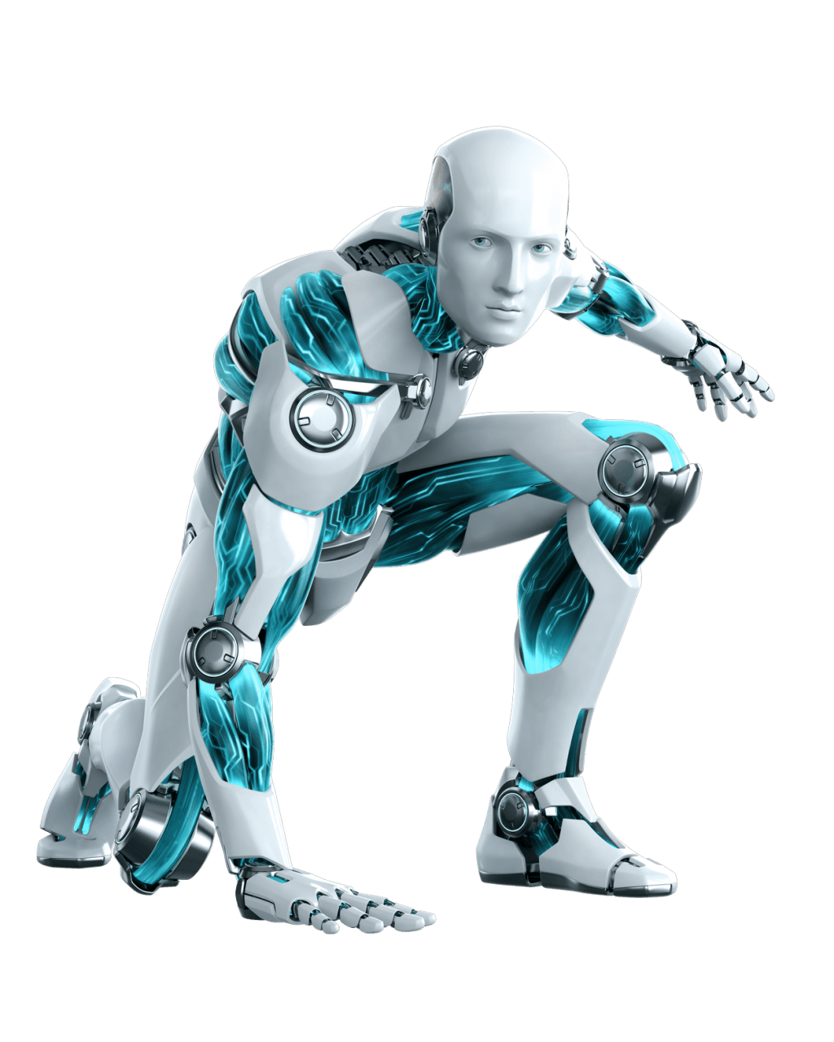
Generating Data
https://arxiv.org/abs/1705.08690
https://arxiv.org/abs/1711.10563
Conducting multi-task learning by generating pseudo-data using generative model
Generate task 1 data
Generate
task 1&2 data
Training Data
for Task 1
Training Data
for Task 2
Multi-task
Learning
Solve task 1
Solve task 2
Notes:
Shin, H., Lee, J. K., Kim, J. & Kim, J. (2017), Continual learning with deep generative replay,
NIPS’17, Long Beach, CA
Kemker, R. & Kanan, C. (2018), Fearnet: Brain-inspired model for incremental learning, ICLR’18,
Vancouver, Canada.

Slide 20
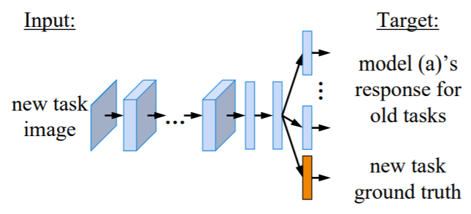
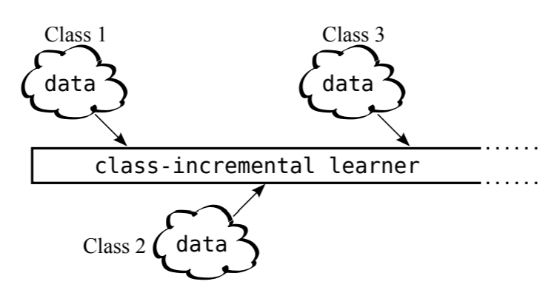
Adding New Classes
Learning without forgetting (LwF)
https://arxiv.org/abs/1606.09282
iCaRL: Incremental Classifier and Representation Learning
https://arxiv.org/abs/1611.07725
Notes:
Active Long Term Memory Networks (A-LTM)
https://arxiv.org/abs/1606.02355

Slide 21
Life-long Learning
Knowledge Retention
Knowledge Transfer
Model Expansion
but NOT Intransigence
but Parameter Efficiency
Notes:
Intransigence: ɪnˋtrænsədʒəns n.
不妥協；不讓步
Constraint:
cannot store all the previous data

Slide 22
Wait a minute ……
Train a model for each task
Learning Task 1
Learning Task 2
Learning Task 3
Knowledge cannot transfer across different tasks
Eventually we cannot store all the models …

Slide 23
Life-Long v.s. Transfer
I can do task 2 because I have learned task 1.
Transfer Learning:
fine-tune
(We don’t care whether machine can still do task 1.)
Learning Task 1
Learning Task 2
Even though I have learned task 2, I do not forget task 1.
Life-long Learning:

Slide 24
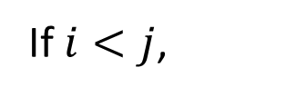
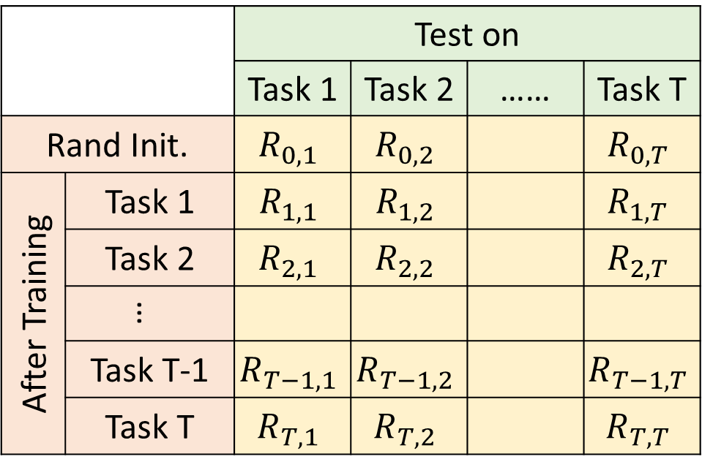
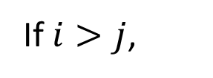
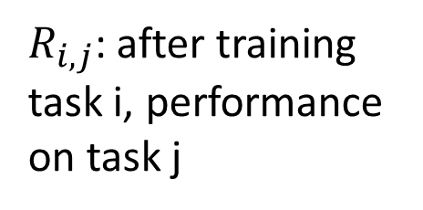
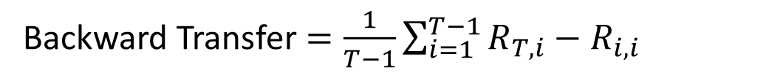
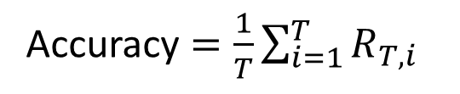
 |  | Test on
 |  | Task 1 | Task 2 | …… | Task T
Rand Init. |  | $$R_{0,1}$$ | $$R_{0,2}$$ |  | $$R_{0,T}$$
After Training | Task 1 | $$R_{1,1}$$ | $$R_{1,2}$$ |  | $$R_{1,T}$$
 | Task 2 | $$R_{2,1}$$ | $$R_{2,2}$$ |  | $$R_{2,T}$$
 | …
 | Task T-1 | $$R_{T−1,1}$$ | $$R_{T−1,2}$$ |  | $$R_{T−1,T}$$
 | Task T | $$R_{T,1}$$ | $$R_{T,2}$$ |  | $$R_{T,T}$$
Evaluation
$R_{i,j}$: after training task i, performance on task j
If $i>j$,
After training task i, does task j be forgot
If $i<j$,
Accuracy $=\frac{1}{T}\sum_{i=1}^{T}{R_{T,i}}$
Can we transfer the skill of task i to task j
Backward Transfer $=\frac{1}{T−1}\sum_{i=1}^{T−1}{R_{T,i}−R_{i,i}}$
(It is usually negative.)
Notes:
GEM

Slide 25
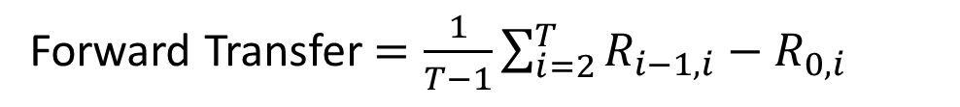
 |  | Test on
 |  | Task 1 | Task 2 | …… | Task T
Rand Init. |  | $$R_{0,1}$$ | $$R_{0,2}$$ |  | $$R_{0,T}$$
After Training | Task 1 | $$R_{1,1}$$ | $$R_{1,2}$$ |  | $$R_{1,T}$$
 | Task 2 | $$R_{2,1}$$ | $$R_{2,2}$$ |  | $$R_{2,T}$$
 | …
 | Task T-1 | $$R_{T−1,1}$$ | $$R_{T−1,2}$$ |  | $$R_{T−1,T}$$
 | Task T | $$R_{T,1}$$ | $$R_{T,2}$$ |  | $$R_{T,T}$$
Evaluation
$R_{i,j}$: after training task i, performance on task j
If $i>j$,
After training task i, does task j be forgot
If $i<j$,
Accuracy $=\frac{1}{T}\sum_{i=1}^{T}{R_{T,i}}$
Can we transfer the skill of task i to task j
Backward Transfer $=\frac{1}{T−1}\sum_{i=1}^{T−1}{R_{T,i}−R_{i,i}}$
Forward Transfer $=\frac{1}{T−1}\sum_{i=2}^{T}{R_{i−1,i}−R_{0,i}}$
Notes:
GEM

Slide 26











Gradient Episodic Memory (GEM)
GEM: https://arxiv.org/abs/1706.08840
A-GEM: https://arxiv.org/abs/1812.00420
Constraint the gradient to improve the previous tasks
$$g$$
$$g$$
$$g^{1}$$
as close as possible
$$g′$$
$$g^{2}$$
$$θ$$
$$θ$$
$$g^{2}$$
: negative gradient of current task
$$g′∙g^{1}≥0$$
$$g^{1}$$
$$g′∙g^{2}≥0$$
negative gradient of previous task
Need the data from the previous tasks
: update direction
Notes:
Episodic
（戲劇、小說等）插曲多的；情節不連貫的；插曲式的

Slide 27
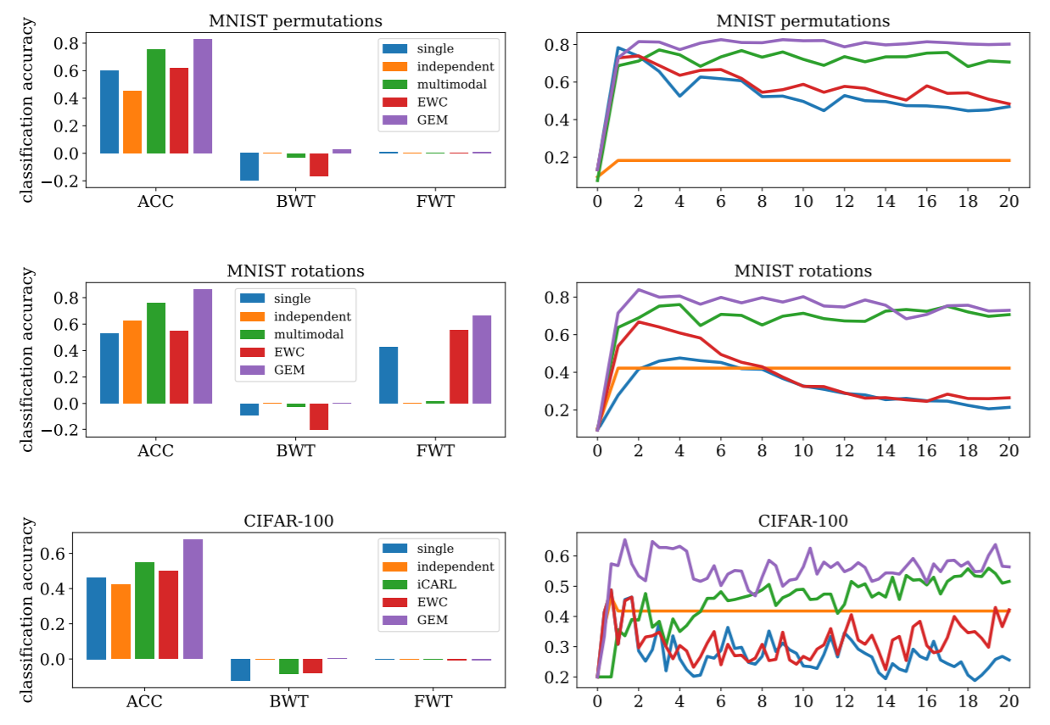

Slide 28
Life-long Learning
Knowledge Retention
Knowledge Transfer
Model Expansion
but NOT Intransigence
but Parameter Efficiency
Notes:
Intransigence: ɪnˋtrænsədʒəns n.
不妥協；不讓步
Constraint:
cannot store all the previous data

Slide 29
Progressive Neural Networks
https://arxiv.org/abs/1606.04671
Task 1
Task 2
Task 3
input
input
input
Notes:
https://arxiv.org/pdf/1606.04671v3.pdf

Slide 30
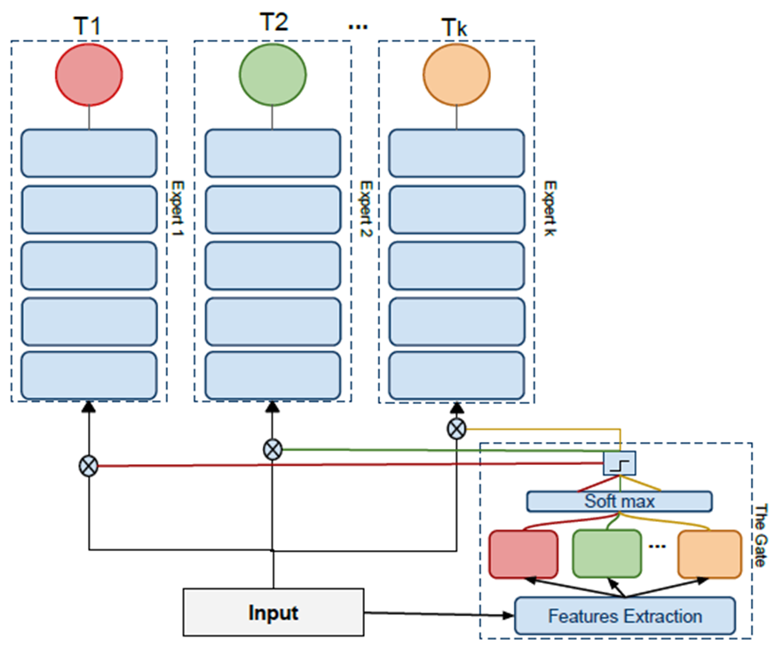
Expert Gate
https://arxiv.org/abs/1611.06194
Notes:
Aljundi, R., Chakravarty, P., Tuytelaars, T.: Expert gate: Lifelong learning with a network of
experts. In: CVPR (2017)

Slide 31
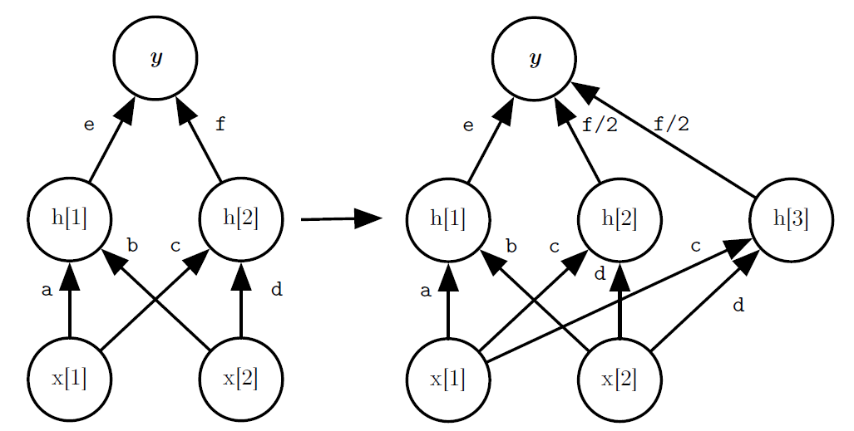
Net2Net
https://arxiv.org/abs/1511.05641
Add some small noises
Expand the network only when the training accuracy of the current task is not good enough.
https://arxiv.org/abs/1811.07017

Slide 32
Concluding Remarks
Knowledge Retention
Knowledge Transfer
Model Expansion
but NOT Intransigence
but Parameter Efficiency
Notes:
Intransigence: ɪnˋtrænsədʒəns n.
不妥協；不讓步
Constraint:
cannot store all the previous data

Slide 33
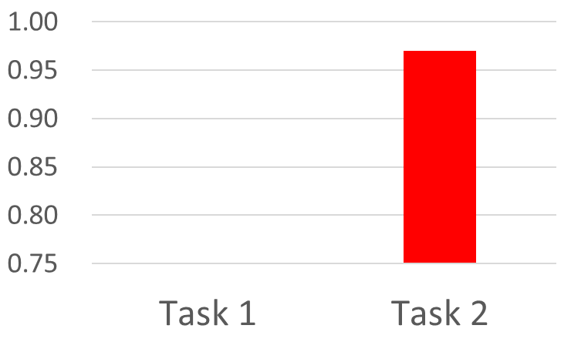

Curriculum Learning
: what is the proper learning order?
Task 1
Task 2
96%
97%
90%
Forget!!!
80%
Task 2
Task 1
97%
97%
90%
62%

Slide 34
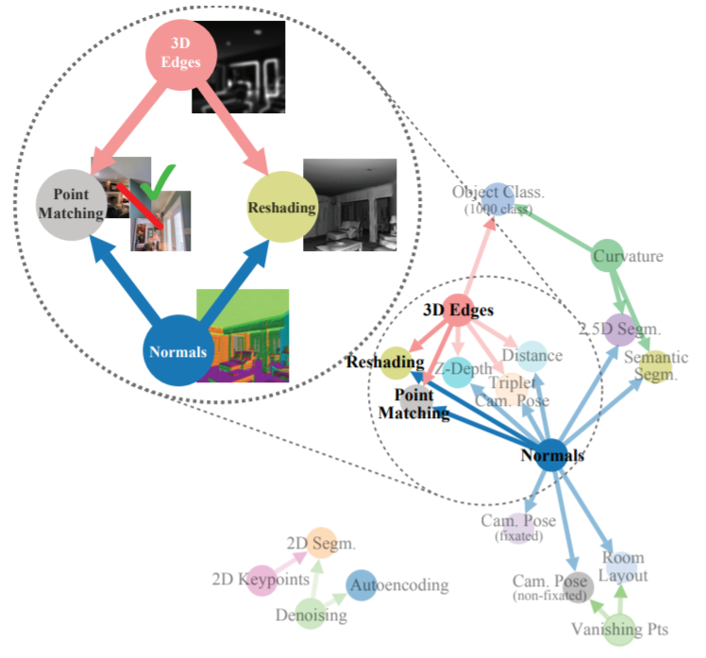
taskonomy
= task + taxonomy
(分類學)
http://taskonomy.stanford.edu/#abstract

